Slide 1
SOFE 3650 – Software Architecture Design

Slide 2
Typical Architectural Design Life-Cycle
Architectural Requirements
Architectural Design
Architectural Documentation
Architectural Evaluation
Architectural Implementation

Slide 3
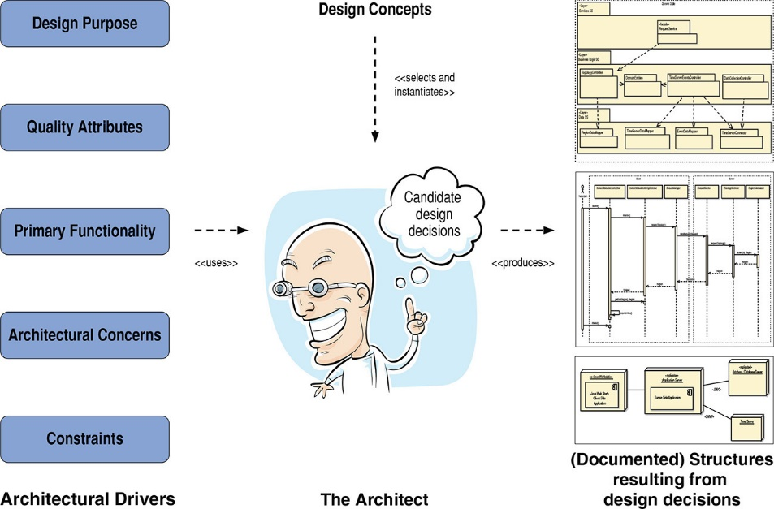
Role of the Software Architect
In general, when designing, a change in some structure to achieve one quality attribute will have negative effects on other quality attributes.
Thus the architect’s job is not one of finding an optimal solution, but rather one of satisficing.
Searching through a potentially large space of design alternatives and decisions until an acceptable solution is found

Slide 4
The Architect Responsibilities
Stakeholder issues, such as choices concerning the use of proprietary, commercial off-the-shelf or open-source components, with their attendant and varying licensing obligations.
Over arching style and structure.
Types of connectors for composing sub-elements.
Package and primary class structure (that is, low-level style and structure when working in an object-oriented development context).
Distributed and decentralized system concerns.
Deployment issues.
Security and other nonfunctional properties.
Post-implementation issues (means for supporting upgrade and adaptation).

Slide 5
Design in Software Architecture
A decision is architectural if it has non-local consequences and those consequences matter to the achievement of an architectural driver.
During initial architectural design, the architect will focus on the primary functionality of the system.
The primary use case
These are captured as interactions among elements and generally occurs after architectural design.
The location and relationships of these elements, however, are constrained by the decisions that were made during architectural design.
if the elements are not defined, located, and connected correctly one may not achieve the quality desired.
Architectural affects internal entity design, i.e. how an entity works internally.
One cannot design an element’s internals until the elements themselves have been defined, and one cannot reason about interaction until several elements and some patterns of interactions among them have been defined.

Slide 6
Quality Attributes
Quality attributes are defined as being measurable or testable properties of a system that are used to indicate how well the system satisfies the needs of its stakeholders.
Quality attributes are the ones that shape the architecture the most significantly.
Quality attributes can be acquired from stakeholders via a Quality Attribute Workshop (QAW)
QAW is a facilitated brainstorming session involving a group of system stakeholders that covers the bulk of the activities of eliciting, specifying, prioritizing, and achieving consensus on quality attributes.
The output of the QAW is therefore a prioritized list of scenarios, aligned with business goals, where the highest-priority scenarios have been explored and refined.
Can be conducted in as little as 2–3 hours for a simple system or as part of an iteration, and as much as 2 days for a complex system.

Slide 7
QAW Steps
Step 1: QAW Presentation and Introductions.
QAW facilitators describe the motivation for the QAW and explain each step of the method.
Step 2: Business/Mission Presentation.
The stakeholder representing the business concerns behind the system presents the system’s business context, broad functional requirements, constraints, and known quality attribute requirements.
The quality attributes that will be refined in later steps will be derived largely from the business/mission needs presented in this step.
Step 3: Architectural Plan Presentation.
The architect will present the system architectural plans as they stand.
This lets stakeholders know the current architectural thinking, to the extent that it exists.
Step 4: Identification of Architectural Drivers.
The facilitators will share their list of key architectural drivers that they assembled during Steps 2 and 3, and ask the stakeholders for clarifications, additions, deletions, and corrections.
The idea is to reach a consensus on a distilled list of architectural drivers that includes overall requirements, business drivers, constraints, and quality attributes.

Slide 8
QAW Steps
Step 5: Scenario Brainstorming.
Each stakeholder expresses a scenario representing his or her concerns with respect to the system.
Facilitators ensure that each scenario has an explicit stimulus and response.
The facilitators ensure that at least one representative scenario exists for each architectural driver listed in Step 4.
Step 6: Scenario Consolidation.
Similar scenarios are consolidated where reasonable.
Consolidation helps to prevent votes from being spread across several scenarios that are expressing the same concern.
Step 7: Scenario Prioritization.
Prioritization of the scenarios is accomplished by allocating each stakeholder a number of votes equal to 30 percent of the total number of scenarios
Step 8: Scenario Refinement.
The top scenarios are refined and elaborated.
Facilitators help the stakeholders put the scenarios in the six-part scenario form of source-stimulus-artifact-environment-response-response measure.

Slide 9
Utility Tree
A way to record ASRs all in one place.
Establishes priority of each ASR in terms of
Impact on architecture
Business or mission value
ASRs are captured as scenarios.
Root of tree is placeholder node called “Utility”.
Second level of tree contains broad QA categories.
Third level of tree refines those categories.

Slide 10
Examples of QA
From ISO 9126
Functionality
Reliability
Usability
Efficiency
Maintainability
Portability
From ISO 25020
Functional Suitability
Performance Efficiency
Compatibility
Usability
Reliability
Security
Maintainability
Portability

Slide 11
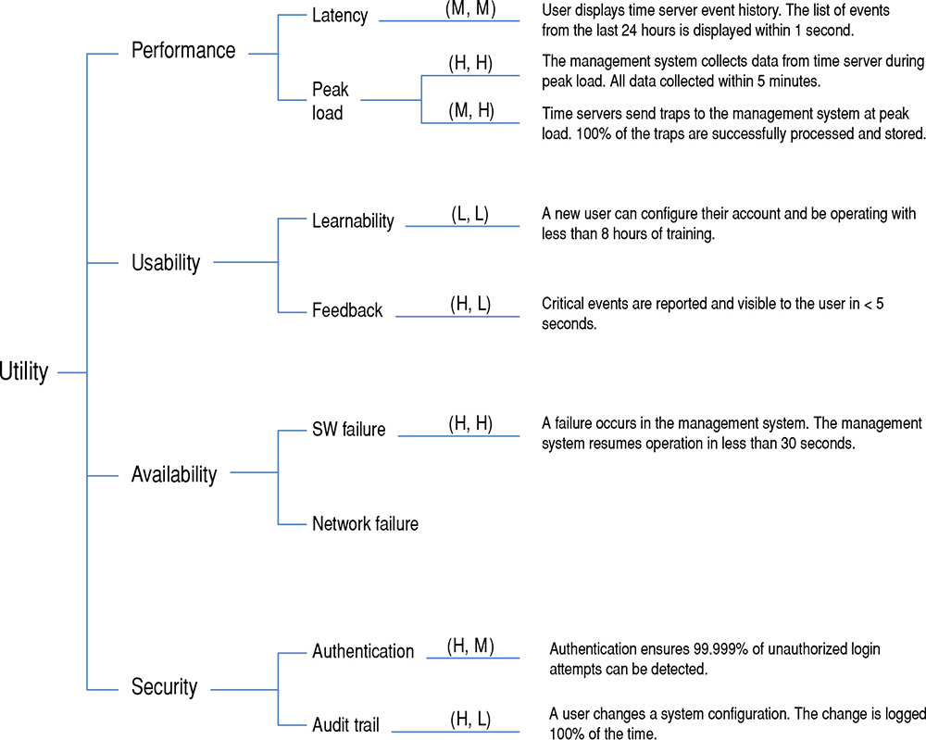
Utility Tree Example
…

Slide 12
Utility Tree: Next Steps
A QA or QA refinement without any ASR is not necessarily an error or omission
Attention should be paid to searching for unrecorded ASRs in that area.
ASRs that rate a (H,H) rating are the ones that deserve the most attention
A very large number of these might be a cause for concern: Is the system is achievable?
Stakeholders can review the utility tree to make sure their concerns are addressed.

Slide 13
Class Exercise
Create a branch of the Utility Tree based on the Manufacturing Process Scenario described below:
A manufacturing process must maintain the pH of a solution in a vat within certain bounds. The pH of the vat is monitored by taking samples every 12 minutes using six pH sensors located at various places in the vat. The samples are stored, and every 12 minutes a control chart is produced showing a moving window of the most recent sample means. The control chart displays between 10 and 40 data points, along with quality control statistics. Its parameters are set by the user.
The program displays and evaluates the control chart, as well as flagging the out-of-control points (data points indicating that the process may be out of control). The program stores all data permanently in data files for later analysis. Each data file contains one day’s pH readings, along with the times the readings were taken.
The program redraws the control chart every 12 minutes. It is also redrawn whenever the user changes any of the parameters governing the chart. This program must be highly reliable. It must accommodate several kinds of pH sensors and allow new brands of sensors to be introduced later. Control charts are an established technique for monitoring industrial processes and are not likely to change.
To simplify the mapping of the components to different software architectures the following components have been identified for the product: Control Chart Display, pH Sensors Collector, Data Quality Analyzer, Data Collection Repository, Control Chart Controller, and Clock.

Slide 14
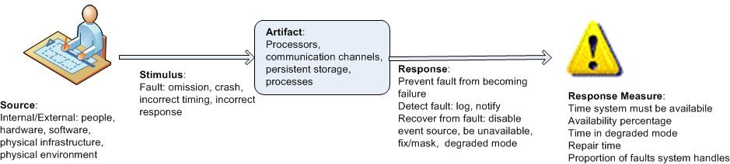
Quality Attribute Scenarios
A practical way to design against quality requirements is consider quality attribute scenarios:
In its most basic form, describes the system’s response to some stimulus.
All other approaches are worse!
The heart of a quality attribute scenario is the pairing of a stimulus with a response.

Slide 15
Quality Scenario – Simple Example
“The game shall change view modes when the user presses the <C> button”.
This functional requirement needs to be associated with quality attribute requirements. For example:
How fast should the function be?
How secure should the function be?
How modifiable should the function be?

Slide 16
A Quality Annotated Scenario
“The game shall change view modes in 500 ms when the user presses the <C> button”.
This revised scenario associates a stimulus (in this case, the pressing of the <C> button) with a response (changing the view mode) that is measured using a response measure (< 500 ms).
The quality attribute scenario adds three other parts:
the source of the stimulus (in this case, the user),
the artifact affected (in this case, because we are dealing with end-to-end latency, the artifact is the entire system)
the environment (are we in normal operation, startup, degraded mode, or some other mode?)
Scenarios are testable.
Similar to the Utility Tree they should be prioritized (X,Y):
X: Corresponds to the importance of the scenario with respect to the success of the system. This is ranked by the customer as L,M,H.
Y: Corresponds to the degree of technical risk associated with the scenario. This is ranked by the architect as L,M,H.

Slide 17
Class Exercise
For the quality branches you defined in the utility tree specify it as a quality attributes scenario.
A manufacturing process must maintain the pH of a solution in a vat within certain bounds. The pH of the vat is monitored by taking samples every 12 minutes using six pH sensors located at various places in the vat. The samples are stored, and every 12 minutes a control chart is produced showing a moving window of the most recent sample means. The control chart displays between 10 and 40 data points, along with quality control statistics. Its parameters are set by the user.
The program displays and evaluates the control chart, as well as flagging the out-of-control points (data points indicating that the process may be out of control). The program stores all data permanently in data files for later analysis. Each data file contains one day’s pH readings, along with the times the readings were taken.
The program redraws the control chart every 12 minutes. It is also redrawn whenever the user changes any of the parameters governing the chart. This program must be highly reliable. It must accommodate several kinds of pH sensors and allow new brands of sensors to be introduced later. Control charts are an established technique for monitoring industrial processes and are not likely to change.
To simplify the mapping of the components to different software architectures the following components have been identified for the product: Control Chart Display, pH Sensors Collector, Data Quality Analyzer, Data Collection Repository, Control Chart Controller, and Clock.

Slide 18
Primary Functionality of the System
There are two important reasons why you need to consider primary functionality when designing an architecture:
You need to think how functionality will be allocated to elements (usually modules) to promote modifiability or reusability, and also to plan work assignments.
Some quality attribute scenarios are directly connected to the primary functionality in the system.

Slide 19
Design Concepts
Generally accepted design principles:
To help achieve high modifiability, aim for good modularity, which means high cohesion and low coupling.
To help achieve high availability, avoid having any single point of failure.
To help achieve scalability, avoid having any hard-coded limits for critical resources.
To help achieve security, limit the points of access to critical resources.
To help achieve testability, externalize state.
. . . and so forth.
Some of the most commonly used design concepts are:
reference architectures, deployment patterns, architectural patterns, tactics, and frameworks

Slide 20
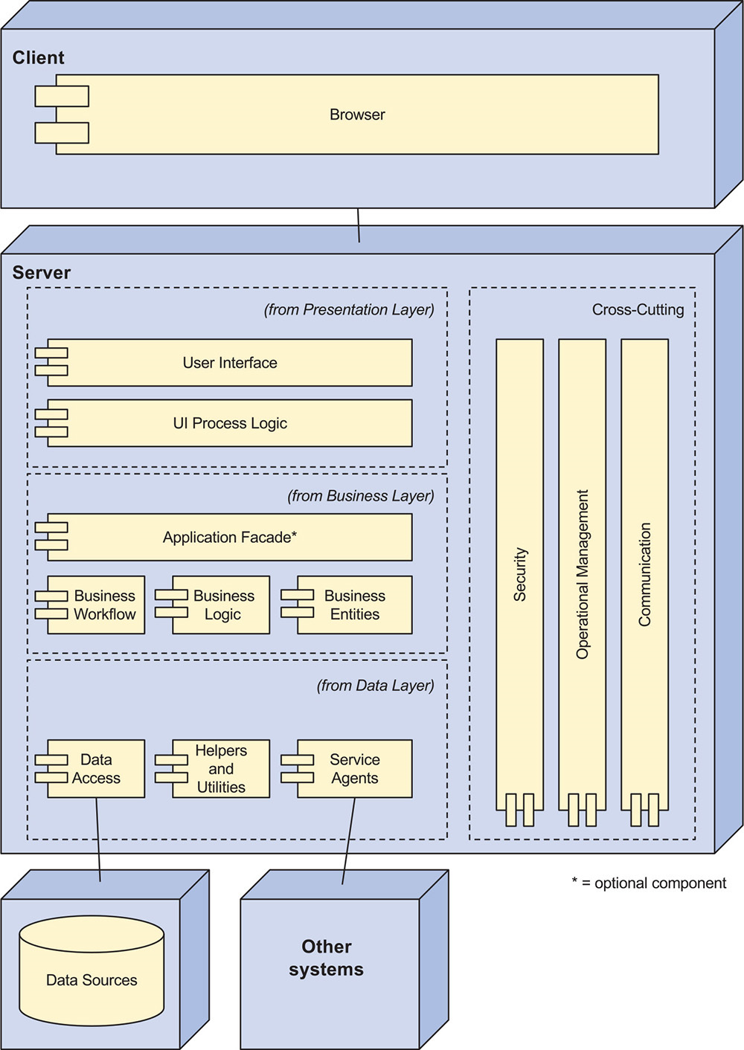
Reference Architectures
Reference architectures are blueprints that provide an overall logical structure for particular types of applications.
For example the Web Application Reference Architecture shown on the right.

Slide 21
Externally Developed Components
You can code the elements obtained from the design concepts or you can associate technologies with one or more of these elements in the architecture.
This “buy versus build” choice is one of the most important decisions you will make as an architect.

Slide 22
Architecture Design Decisions
The act of making a decision is a process, not a moment in time.
Experienced architects, when faced with a design challenge, typically entertain a set of “candidate” decisions from this set, they choose a best candidate and instantiate that.
In the early stages of design, decisions focus on the biggest, most critical choices that will have substantial downstream consequences.
Interpreting the patterns from a pattern catalog is a critical part of the selection activity for an architect. Each candidate pattern must be chosen and its instantiation must be analyzed.
Finally, once a design decision has been made, you should think about how you will document it.
Informal (emails, messages ..), formal (safety critical ..), sketches

Slide 23
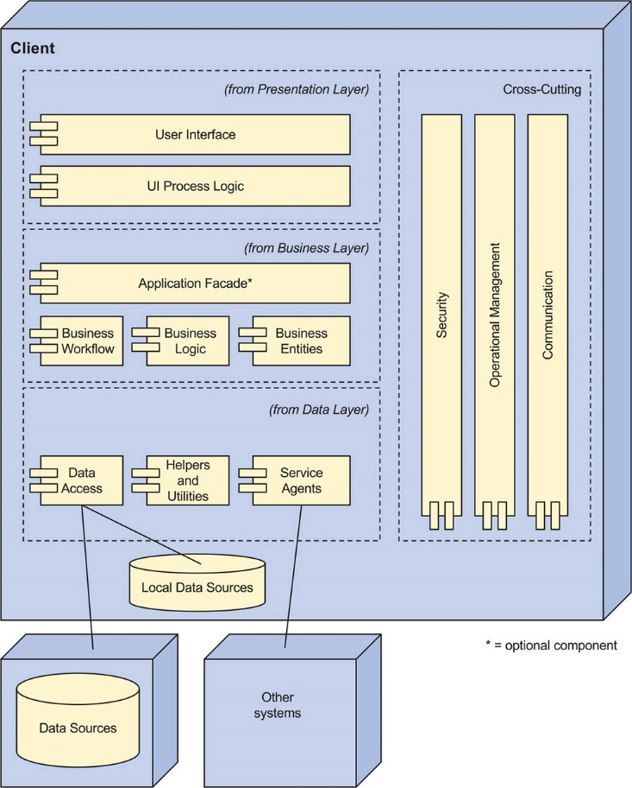
In-Class Exercise
For the Cash Register Requirements example map the core components that you have previously defined into the Rich Client applications framework.
Note: In the case where there are no requirements listed to match one of the components in the framework consider what function might be there for cash registers.

